Slide 1
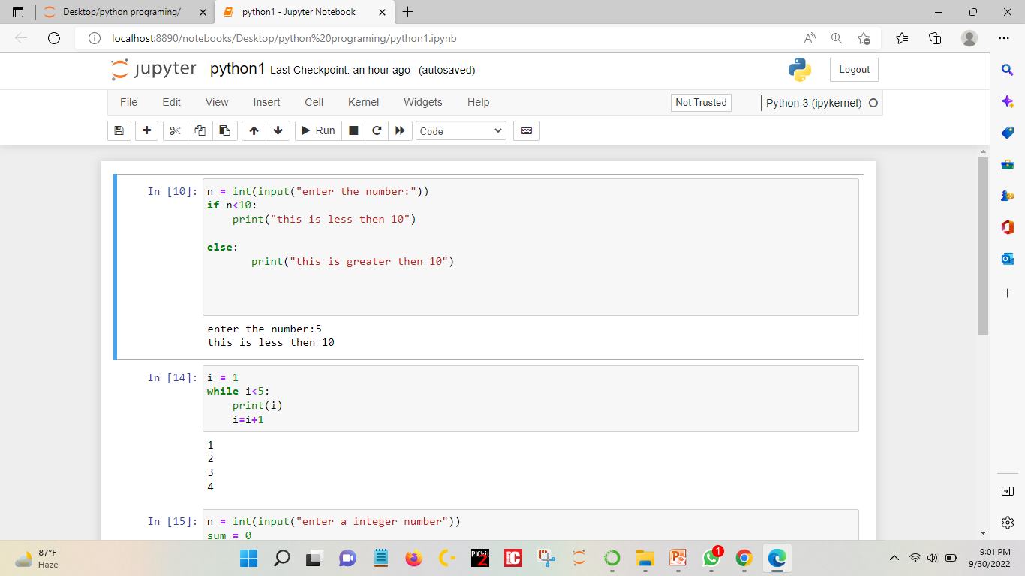
Assignment 2

Slide 2
